Slide 1
Employee Data Analysis using Excel
STUDENT NAME: YUVAN.B.S REGISTER NO: 312215355/asunm148722cca034DEPARTMENT: B. Com (Computer Application)COLLEGE: J. H. A. Agarsen College

Slide 2
PROJECT TITLE
Employee Performance Analysis using Excel

Slide 3

AGENDA
3/21/2024 Annual Review

Slide 4
PROBLEM STATEMENT
In the Excel analysis shows Employee performance rating. In this analysis tell there are medium rated employees only more, others rating are not like that.
In the analysis the high and very high level rating is very low and low level rating is second place. We must improve this table.

Slide 5
PROJECT OVERVIEW
.
This project is analyzing the Rating of employees either male or female employees. It is used to find the Employee performance.

Slide 6
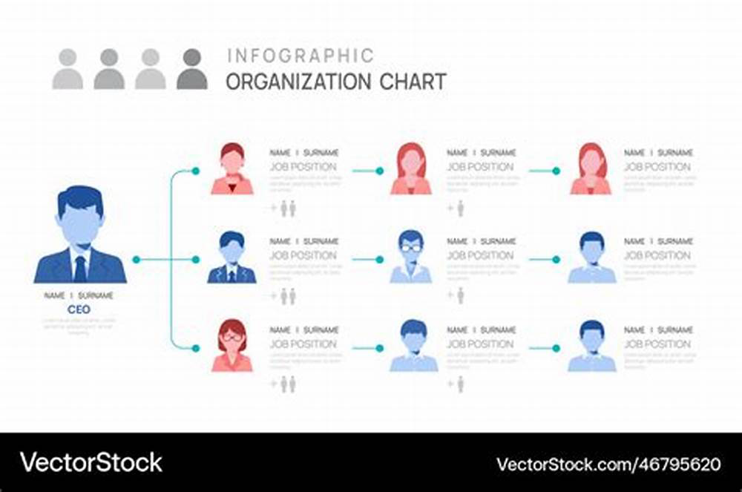

WHO ARE THE END USERS?

Slide 7

OUR SOLUTION AND ITS VALUE PROPOSITION
Conditional formatting – missingFilter – removeFormula – Performance levelPivot Table – SummaryGraph – Data visualization

Slide 8
Dataset Description
Employee dataset I got from kaggle, it has 26 features I am using 9 features. The employee Id in number, name is in text, using employee type, business unit, Employee status, Performance score, Employee rating are used to analyzed.

Slide 9

THE "WOW" IN OUR SOLUTION
Performance Level Column =IFS(Z8>=5,”VERY HIGH’,Z8>=4,”HIGH”,Z8>=3,”MED”,”TRUE”,”LOW”)
3/21/2024 Annual Review

Slide 10
MODELLING
Data Collection1)Kaggle2)edunet3)Employee data setFeature Collection1)Employee Id2)Employee type3)Performance level etc..AnalyzePivot tableGraphSlicerEditingFontsFilterHighlightFormulas

Slide 11
RESULTS

Slide 12
conclusion
The analysis of employee performance ratings reveals that a majority of employees are rated at medium or low levels. This indicates that while a significant portion of the workforce meets basic expectations, there is room for improvement in achieving higher performance standards. Moving forward, the focus should be on targeted training, support, and motivation to elevate more employees to high-performance levels, thereby enhancing overall productivity and organizational success.

